Slide 1
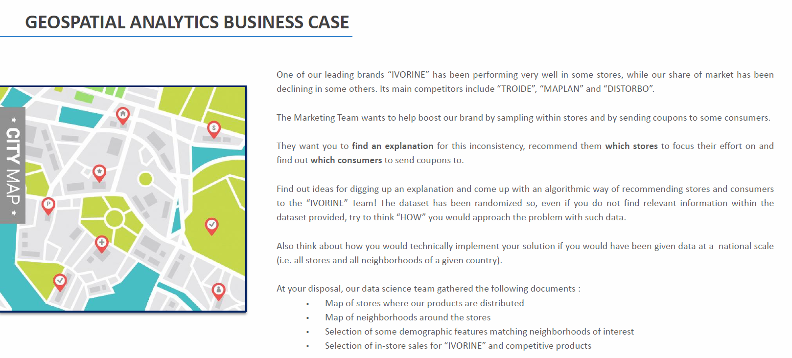
Case Study

Slide 2
Main Questions (1/2)
How would you allocate sales to neighborhoods via Trade Areas??
Help questions: Can you find relationship between store sales and demographic data? How can you mix both? Can you come up with an algorithm that would help understand what geographical area is reached by which store? Is “distance to the store” accurate enough?
2. Understand sales per neighborhood and compare
How can we assess if a neighborhood is good or not for us? How can we compare a store against another?

Slide 3
Main Questions (2/2)
3. Give a recommendation on which stores to maintain sampling/stop/start sampling based on potential. Same for neighborhoods
Help questions: now that you have identified that a store is good or bad, can you figure where the main opportunities are? Where can we grow our market? Which neighborhoods /stores are the most interesting for us?
4. Explain findings + think about how to solve the problem up to country level (scale)
How would you explain your conclusions to business people who are not familiar to this dataset? What about if we had 600 demographics and 35MM rows, how would you approach the question programmatically?

Slide 4
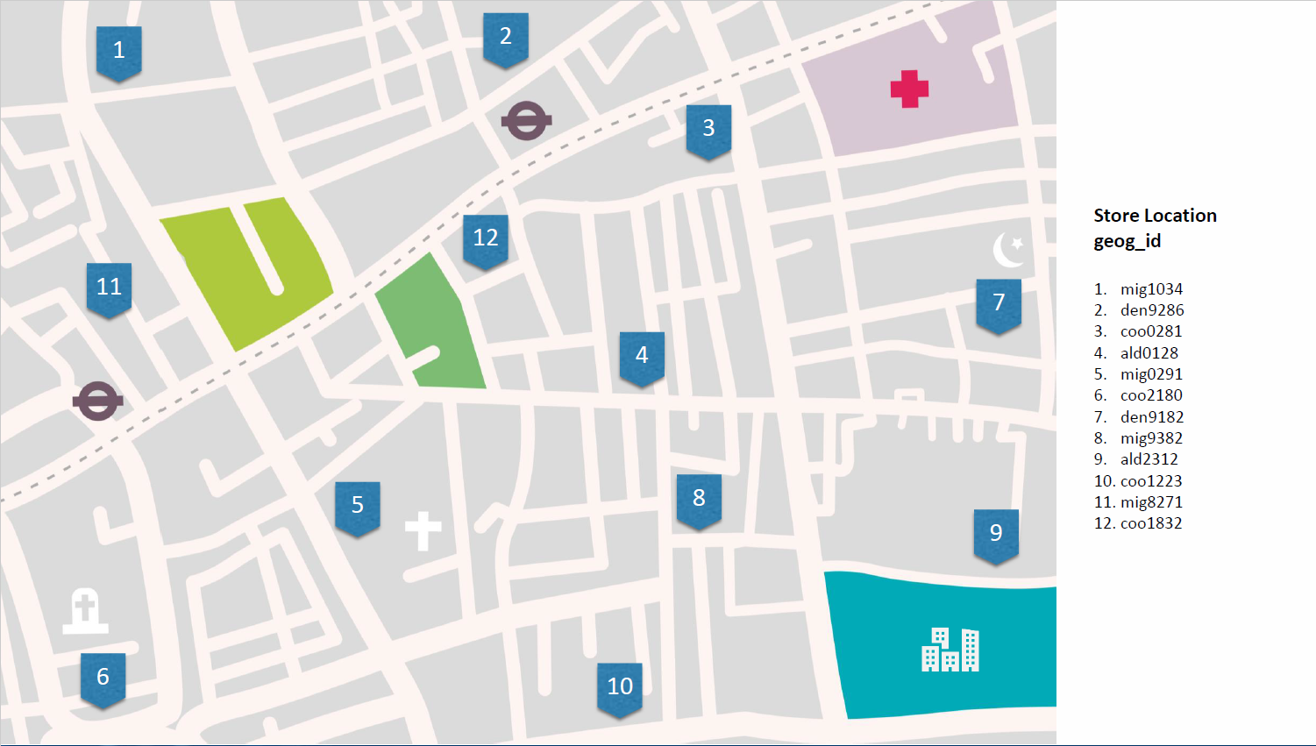

Slide 5
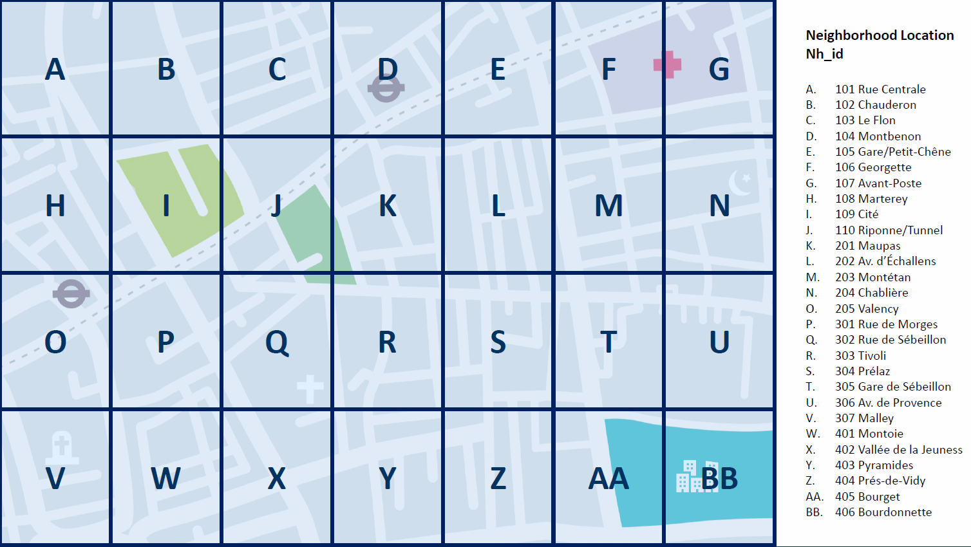

Slide 6
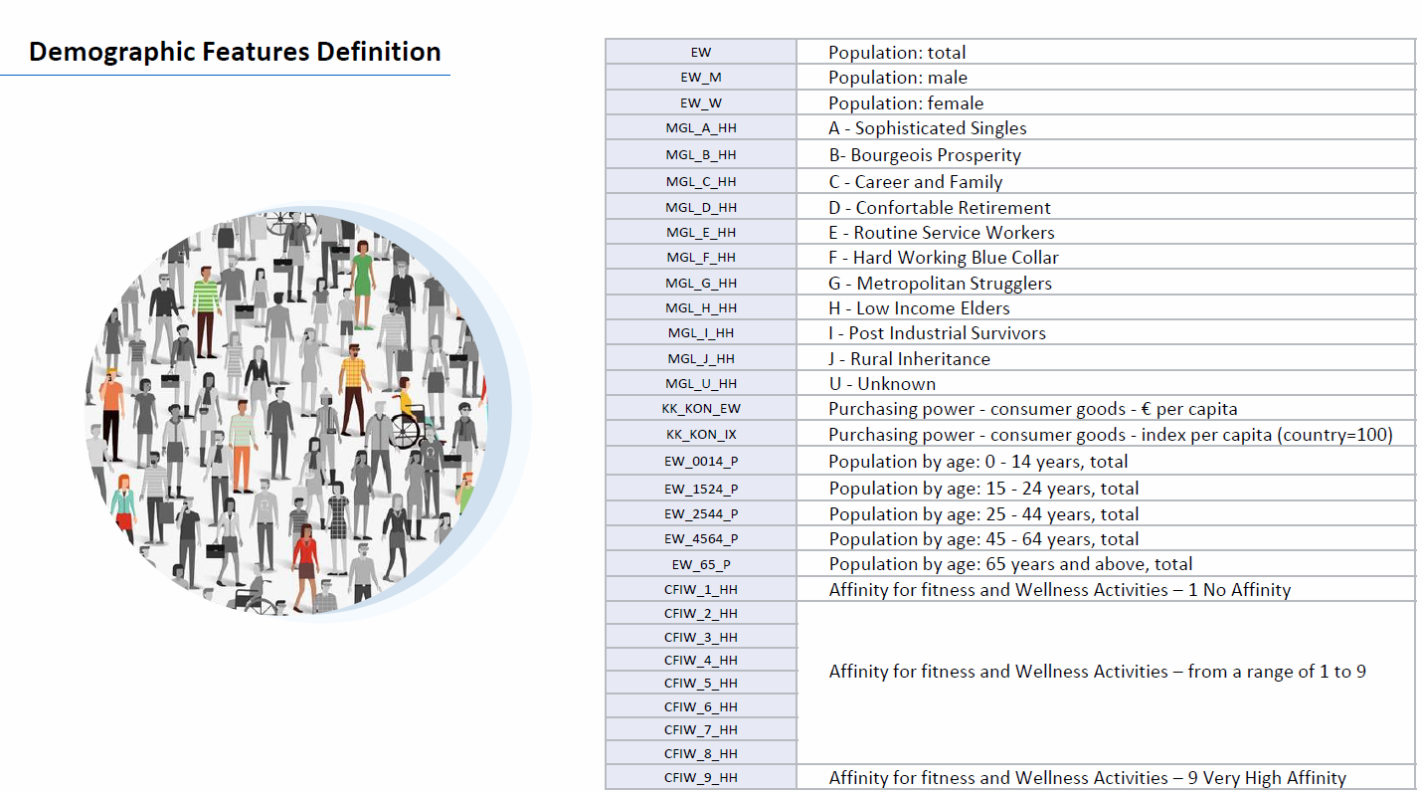

Slide 7
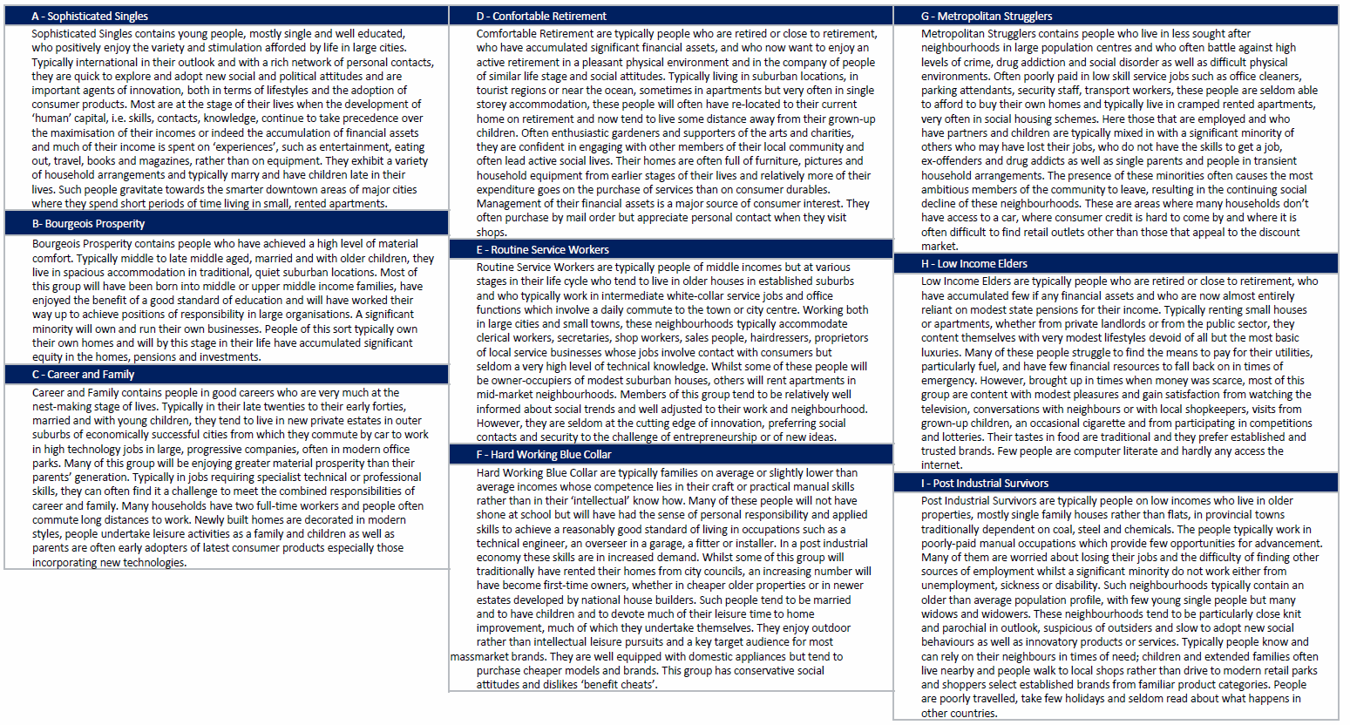

Slide 8
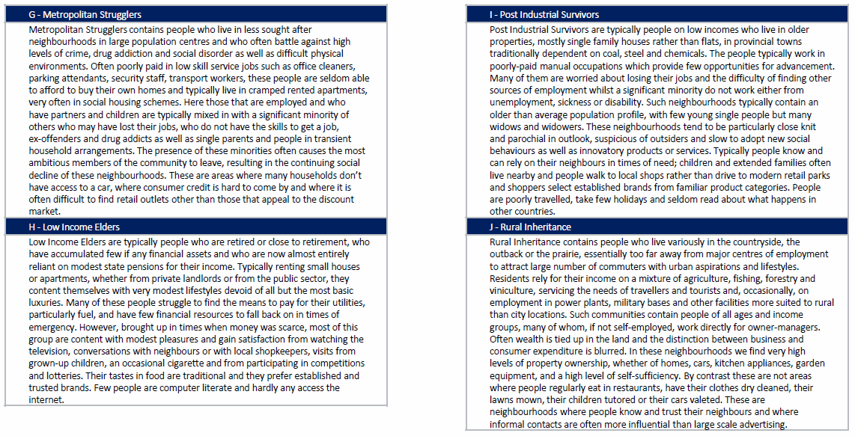

Slide 9
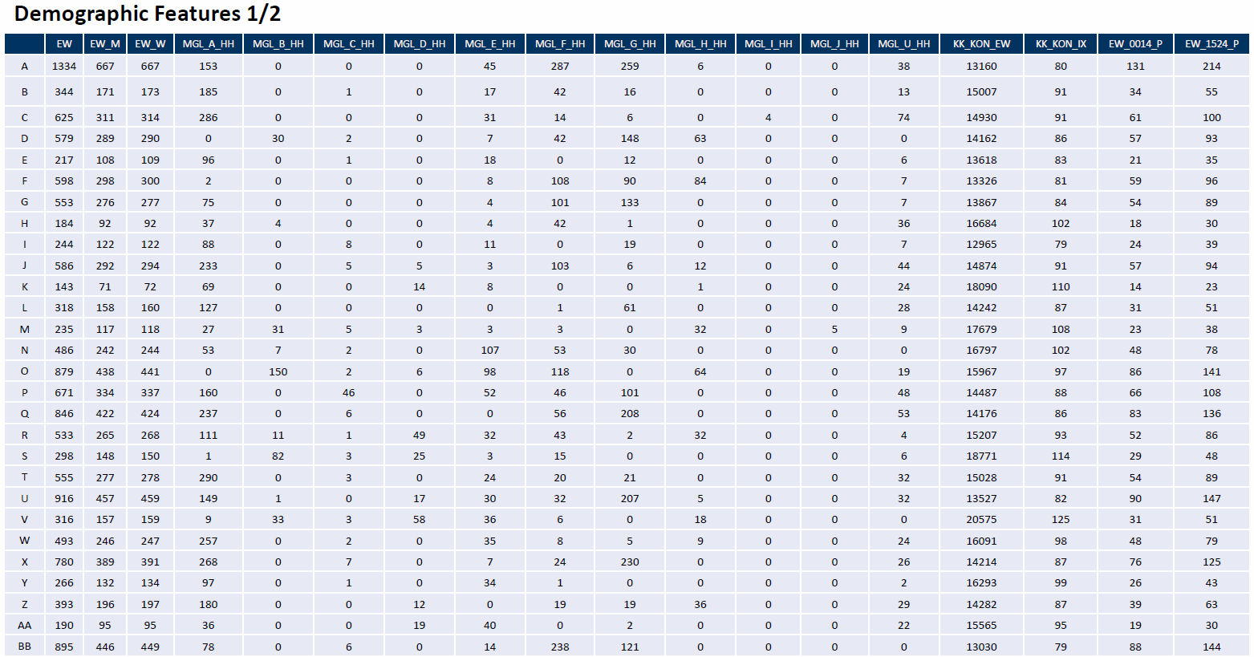

Slide 10
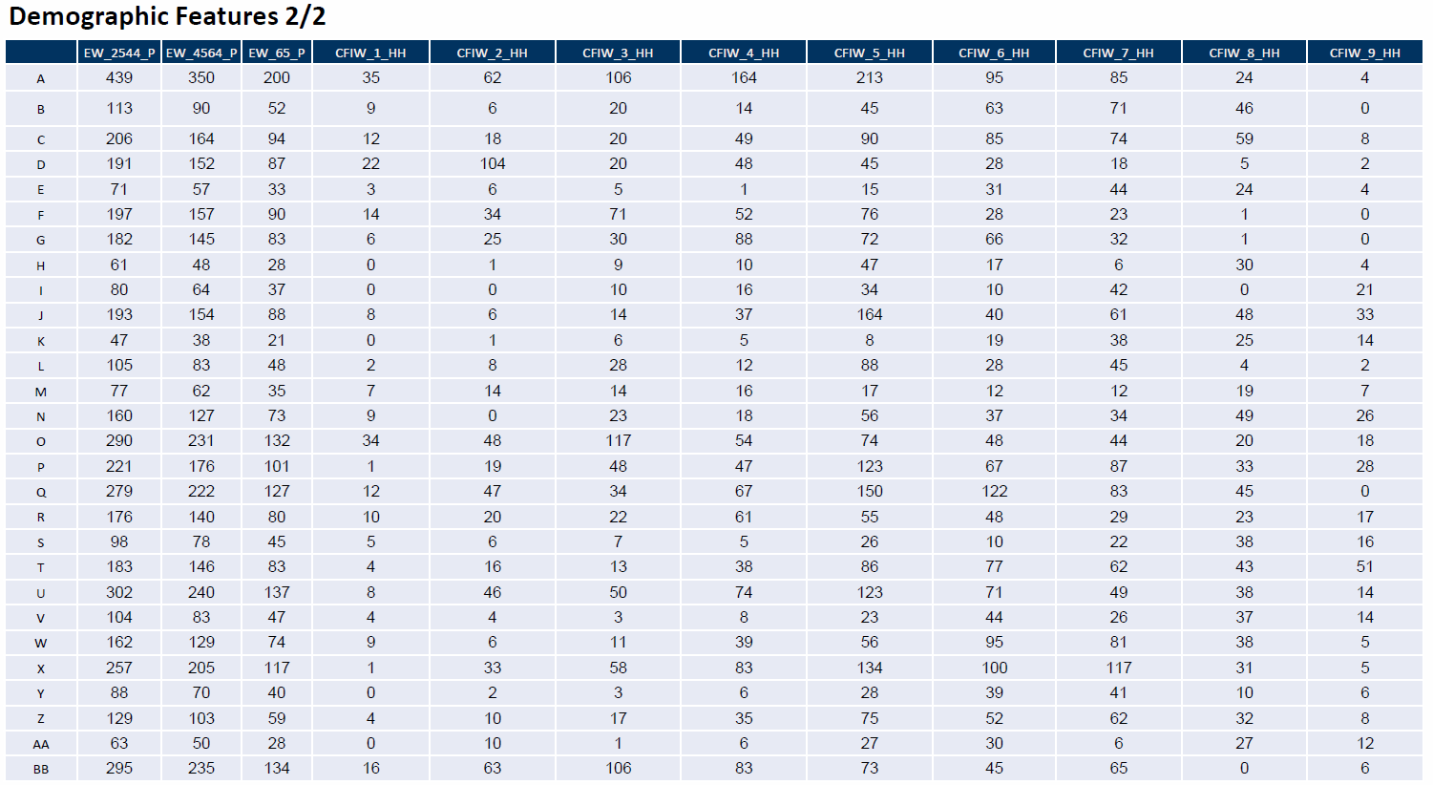

Slide 11
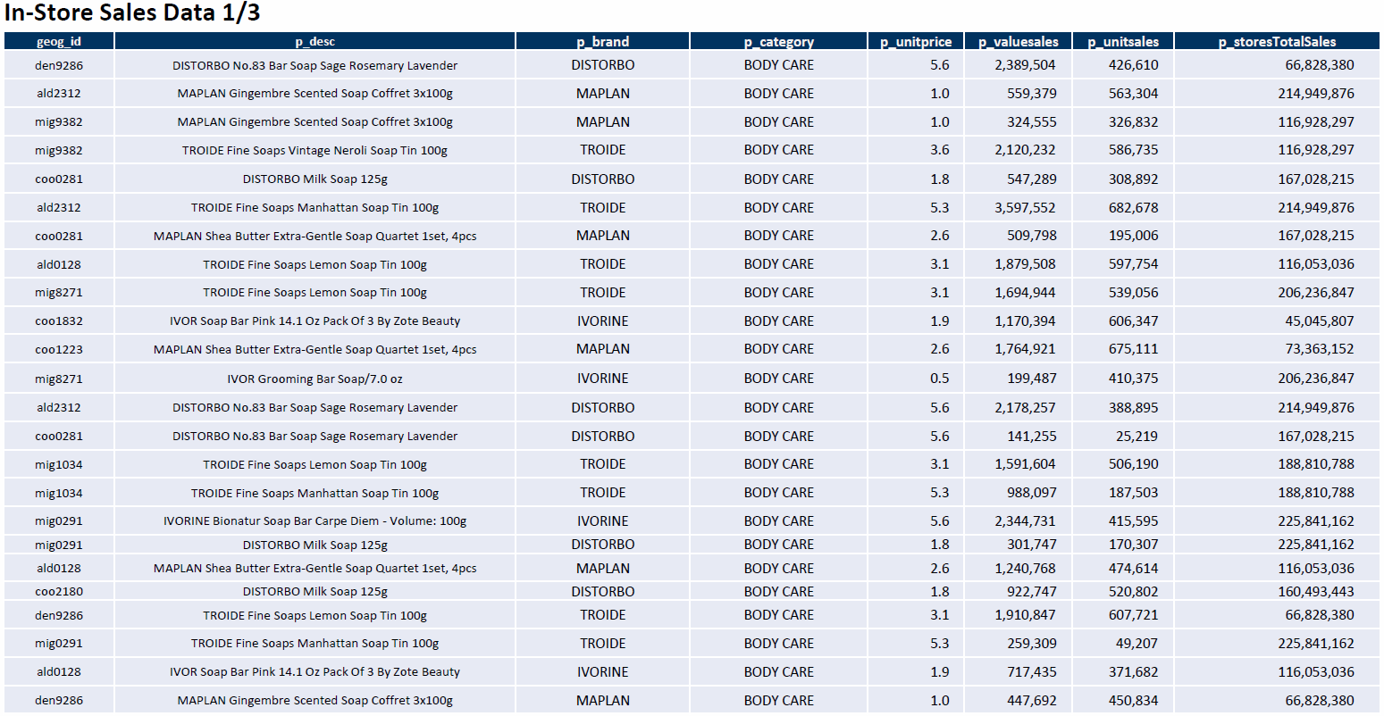

Slide 12
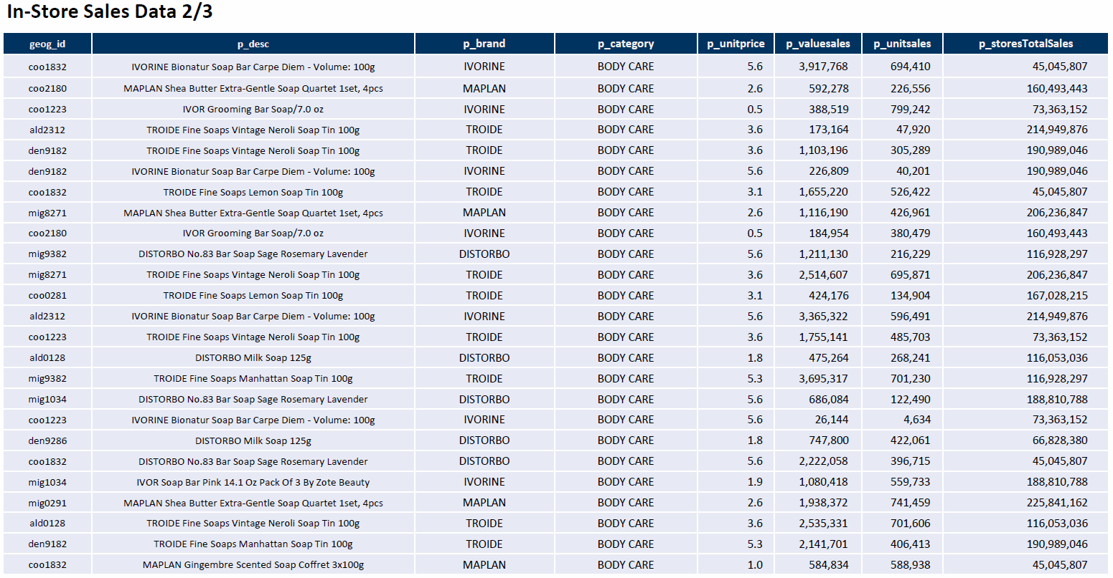

Slide 13
